Slide 1


Titolo presentazione sottotitolo
Data Mining and Text Mining Project
A.A. 2020/2021
Predictive maintenance of air conditioning systems in electrical control units
Mattia Surricchio
Paolo Fornoni
Sergio Placanica
Milano, XX mese 20XX

Slide 2
Introduction
The goal of the project is the predictive maintenance of air conditioning systems in electrical control units, operating next to telecommunications antennas.
2605 sites
2071 in training set
534 in test set
dataset
Target class | Frequency | Percentage
Positive | 3583 | 0.58 %
Negative | 617717 | 99.42 %
136 features
10 months
Start 2019-04-10
End 2020-02-03
Notes:
Cos’è predictive maintenance: si occupa di predirre il guasto di sistemi e/o dispositivi
Applicazione attuale: condizionatori applicati a antenne di trasmissione
Dataset contiene 300 giorni per ogni sito. Hold out di siti: un sito appare solo nel training set o nel test set
Dataset analysis: Il numero di giorni in cui c’è stato un guasto è sicuramente minore del numero di giorni in cui tutto funziona correttamente

Slide 3
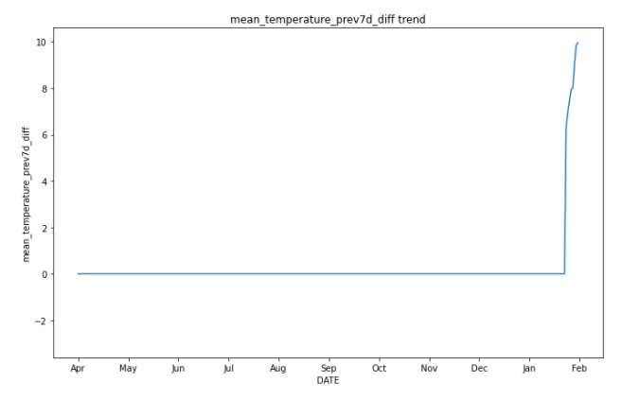
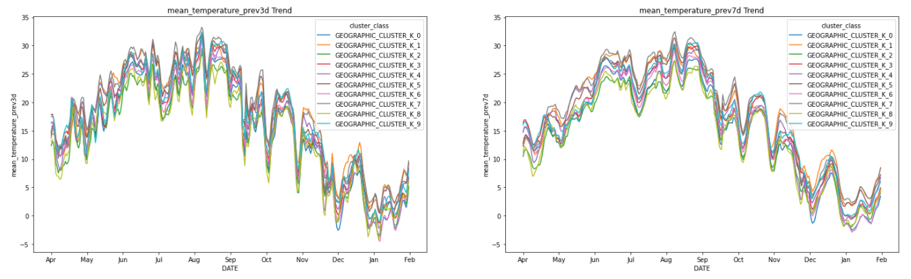
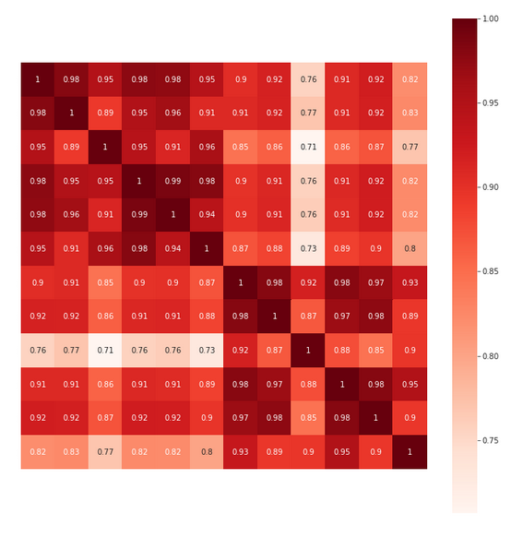
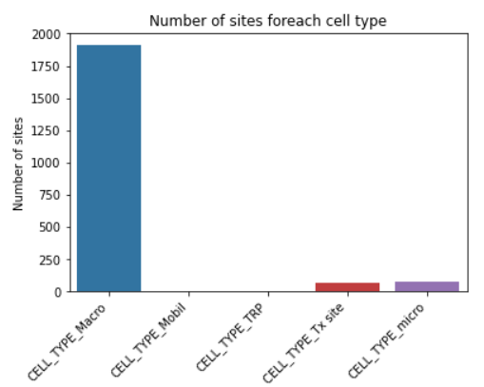
Data exploration and data engineering
DATE
Took apart in month and day
Encoded month as categorical feature
Encoded day using sine/cosine
Dropped - 3 new features
Forecasted Features
Identical to the past ones
Dropped features NEXT
Time frame
Every model prefer a bigger time frame
Our target has a 14 days time frame
Dropped features with time frame 3 and 7
SITE_ID
The model could learner to recognize specific sites instead of generalizing
Dropped
CELL_TYPE_X
Unbalanced distribution
15 sites don't belong to any CELL_TYPE_X
Dropped
Correlated Features
Some features have a correlation higher
than 90%
Dropped
AIRCOM_SUM_PREV_X
By shifting this variable back of fourteen days you get the exact distribution of the target
Dropped
 | Precision | Recall
Brute force model performance | 97.16% | 98.35%

Slide 4
Models - XGBoost
Metric | Cross-Val
Precision | 82.57%
Recall | 86.27%
F1-Score | 84.38%
AUC Prec-Rec | 89.15%
5-fold stratified cross-validation
Metric | Test
Precision | 3.86%
Recall | 13.96%
F1-Score | 6.05%
AUC Prec-Rec | 1.65%
Weighted Recall | 10.27%
SITE_ID hold out

Slide 5
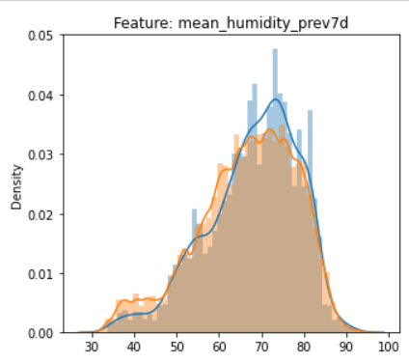
Conclusions
Our model performs well if using a random hold-out criteria, but it is not capable of generalizing over unseen sets of SITES
The data might not be suitable for a correct classification process due to overlapping distributions and heavily unbalanced target classes
Suggestion:
If the goal is the predictive maintenance of new sites we suggest to collect more technical data of the air conditioner
If the goal is the predictive maintenance of a known number of sites in the future, we suggest a temporal hold-out for testing
Notes:
Dati i precedenti risultati in testing abbiamo tratto le possibili seguenti conclusioni:
Il dataset potrebbe essere non adatto per il task richiesto, tutte le features hanno distribuzioni pesantemente overlapping fra classi negative e classi positive
In base al task richiesto, suggeriamo le modifiche citate nella slide

